Slide 1
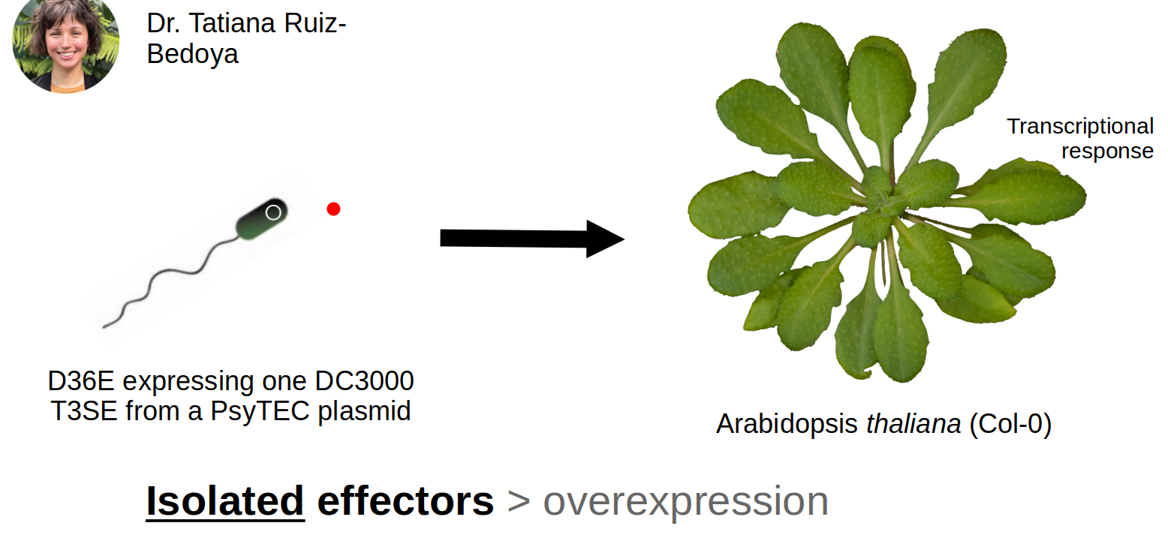
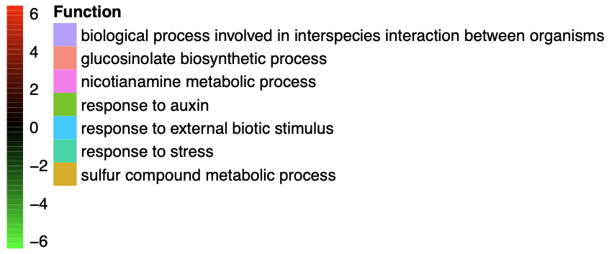



Pseudomonas syringae Type-III Secreted Effectors Elicit Unique Transcriptional Responses in Arabidopsis thaliana
Nicholas Garcia, Pauline Wang^{1,2}, Calvin Mok^{1,2}, Darrell Desveaux², David Guttman^{1,2}
¹ Centre for the Analysis of Genome Evolution and Function, University of Toronto
² Department of Cell & Systems Biology, University of Toronto
Introduction
The bacterium Pseudomonas syringae destroys millions of dollars of crops as a hemibiotrophic phytopathogen.
P. syringae enters the stomata and injects its type-III secreted effector proteins^{[1]} into the symplast to disable host immunity. The plant responds with a transcriptional counter-attack (PAMP-triggered immunity, or PTI).
But does each effector induce a unique transcriptional response in the plant?
We’ve adapted a system developed by Wei et. al^{[2]} and Laflamme et. al^{[3]} to answer that question:
Computational Pipeline
Results cont.
Table 2: DEGs at 1 hour post-infection by effector treatment. Red rows are up-regulated and green genes are down-regulated.
.fastq files
FastQC
fdsfsfsdf
Trimmomatic
Effector* | Locus | Locale | Regu-lation | Product
HopN1a | AT1G53035 | Chloroplast | Up | Transmembrane protein
HopN1a | AT5G51720 | Chloroplast | Down | NEET, involved in ROS homeostasis
HopB1a | AT2G45080 | Cytoplasm | Up | Cyclin P3, enables protein kinase binding
HopAB1j | AT1G08630 | Cytosol | Up | THA1, degrades Thr → Gly
HopAB1j | AT1G68050 | Cytosol & nucleus | Up | Part of SCF uqituitin ligase complex
HopAB1j | AT1G06160 | Nucleus | Up | ORA59, master regulator of JA pathway
HopAB1j | AT4G33980 | Nucleus | Up | COR28
HopAB1j | AT3G48360 | Nucleus | Down | BT2, part of TAC1-mediated telomerase pathway
.bam alignment files
Hisat2
FastQC
.fastq files
TAIR10 reference genome
featureCounts
.csv count files
Enriched Genes
Deseq2
gProfiler2
Enriched GO Terms
Figure 2: DEG patterns by treatment 8 hours post-infection
Results
It wouldn’t kill you to have an image here too.
Figure 1: The model system we used to study individual effectors
Methods
Infection:
Pressure infiltrate the following well-characterised P. syringae effectors, suspended in 10 mM MgSO4 at OD600 = 0.0002, in into A. Thaliana in biological triplicate:
D36E::HopN1a
Cleaves PsbQ in chloroplast's photosystem II to suppress SA signalling
D36E::HopB1a
Cleaves BAK1 at the membrane to suppresses PTI
D36E::HopAB1j
Ligates ubiquitin to FLS2 at membrane to suppress PTI
With D36E::EV and 10 mM MgSO4 as controls, leaves were frozen 1h and 8h post-infiltration.
RNA Extraction & Sequencing:
Frozen leaves were ground in LN2 via mortar & pestle, then suspended in TRIzol.
Centrifuged then supernatant was mixed with chloroform
Centrifuged again and span down through RNEasy spin column kit
Samples were stored at -80°C
Samples were sequenced on an Illumina NextSeq 2000
* All effectors were administered by D36E on a plasmid vector
(Log2fold change)
Discussion
1 hour post-infection
HopN1 demonstrates locale specificity, HopAB1 & HopB1 less so
HopN1 NEET and HopAB1j ORA59, SCF demonstrate functional specificity, HopB1 less so
8 hour post-infection
Unique expression patterns visible across all treatments
Stress response activation and auxin
(Log2fold change)
Figure 3: DEG patterns by treatment 1 hour post-infection
Conclusion
D36E::HopAB1j, D36E::HopB1a, and D36E::HopN1a induce unique transcriptional responses in A. Thaliana.
Their “transcriptional fingerprints” are partially capable of characterising localisation and/or functional outcomes.
Table 1: Genes with significantly-altered expression
Data comparison* | Timepoint post-infection | Total | Induced | Repressed
HopN1a | 1 hour | 2 | 1 | 1
HopN1a | 8 hours | 14 | 4 | 10
HopB1a | 1 hour | 1 | 1 | 0
HopB1a | 8 hours | 960 | 659 | 301
HopAB1j | 1 hour | 5 | 4 | 1
HopABj | 8 hours | 543 | 474 | 69
References
Xin X, Kvitko B, He SY. “Pseudomonas syringae: what it takes to be a pathogen”. Nat Rev Microbiol, 16, 5, 2018, pp. 316-318. 10.1038/nrmicro.2018.17
Wei H, Chakravarthy S, Mathieu J, Swingle B, Martin G, Collmer A. “Pseudomonas syringae pv. tomato DC3000 Type III Secretion Effector Polymutants Reveal an Interplay between HopAD1 and AvrPtoB”. Cell Host & Microbe, 17, 2015, pp. 752-762. 10.1016/j.chom.2015.05.007
Laflamme B, Dillon M, Martel A, Almeida R, Desveaux D, Guttman D. “The pan-genome effector-triggered immunity landscape of a host-pathogen interaction”. Science, 367(6479), 2020, pp. 763-768. 6/science.aax4079
HopB1a
HopAB1j
HopN1a
* All effectors were administered by D36E on a plasmid vector

